Slide 1

Project Capstone
Extractive summariser using BERT model
Applied Artificial Intelligence
(Tech Immersion and Placement Programme)
3 April 2020
Presenters: Eugin Lee & Seng Tian

Slide 2
Agenda
1
Project Goal
2
Methodology and Design
3
Software Architecture
4
Insights: ROGUE, not BLEU
5
Project Demonstration
6
Learnings & Recommendations
7
Questions and Answers

Slide 3

Project Goal
To highlight key points in a text corpus
Use summarisation technique:
BERT
To provide an annotation tool

Slide 4
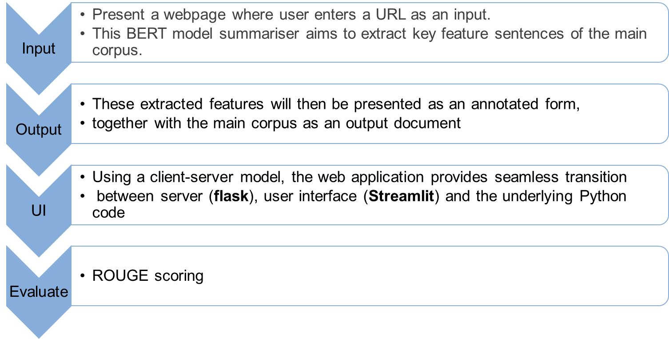
Methodology & Design

Slide 5
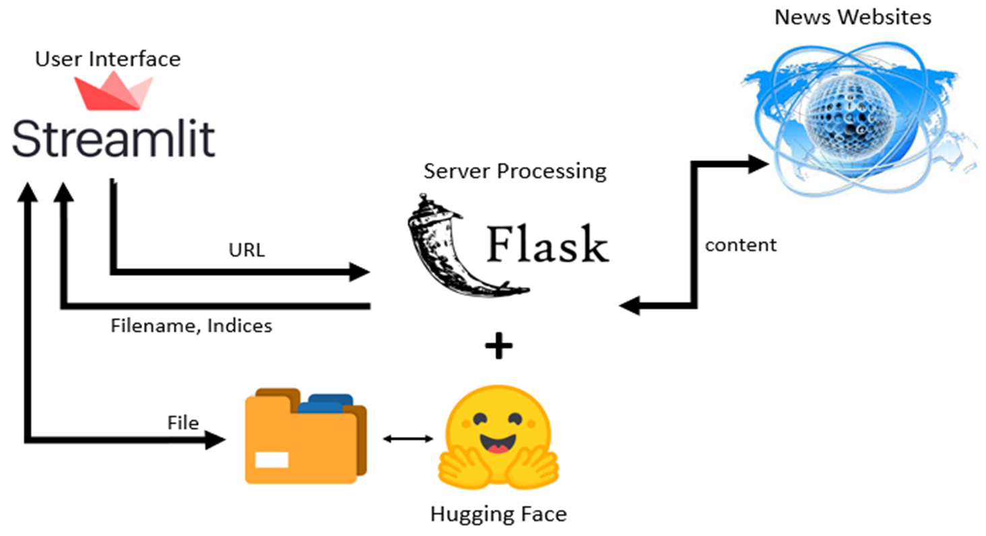
Software Architecture

Slide 6

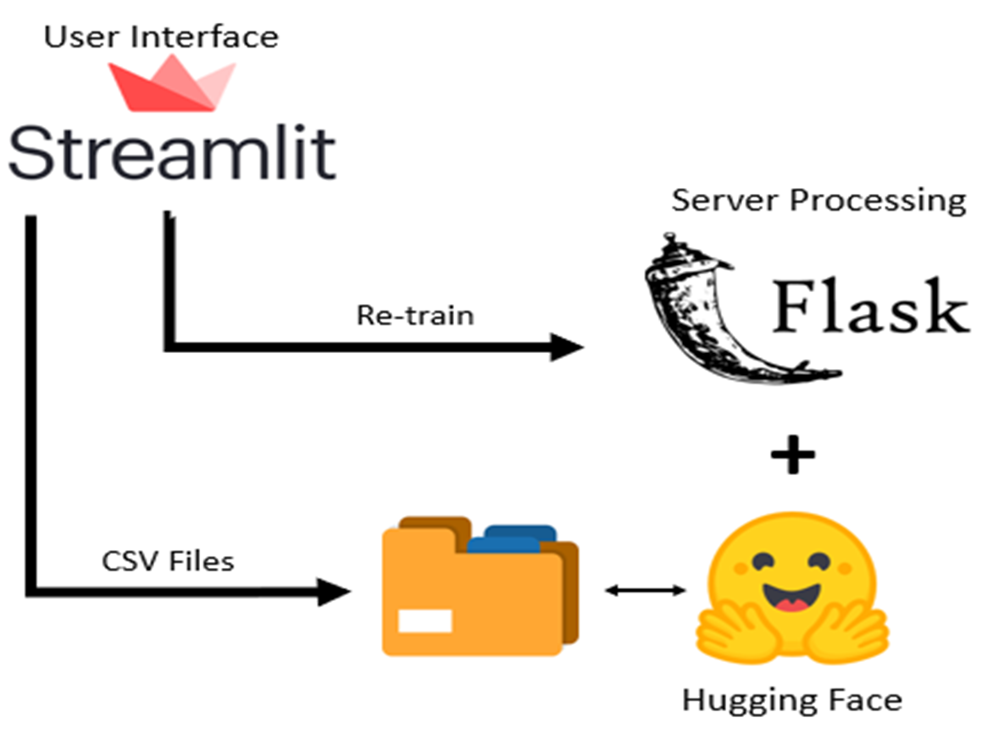
Feedback

Slide 7
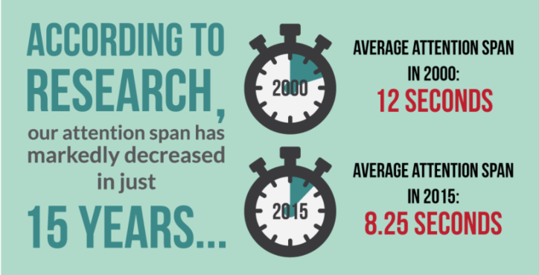
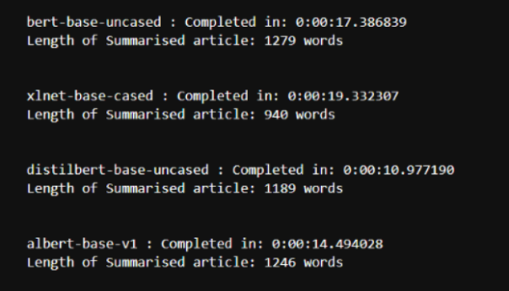
Insights: Choosing DistilBert
Original model (base BERT): 17 secs
Attention span: ranges between 8 and 12 seconds
Original model: 17 seconds is too long
Solution:
Use distillBERT, faster, same performance
Use “loading animation” to create loading illusion
New model (distillBERT): 10 secs

Slide 8
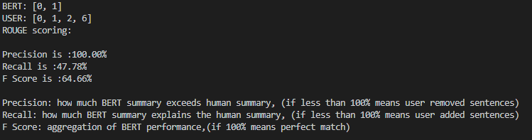
Insights: ROGUE, not BLEU
Target Objective
ROUGE
BLEU
to compare BERT generated summary against user summary
ROUGE provide us the recall, precision and the F-score which give us insights on whether the BERT summary is too vague or too rich.
BLEU only gives a BLEU score (between 0 and 1) and no insights on how to improve.
Set of Summarised corpus
User agrees with BERT
User selected more sentences

Slide 9
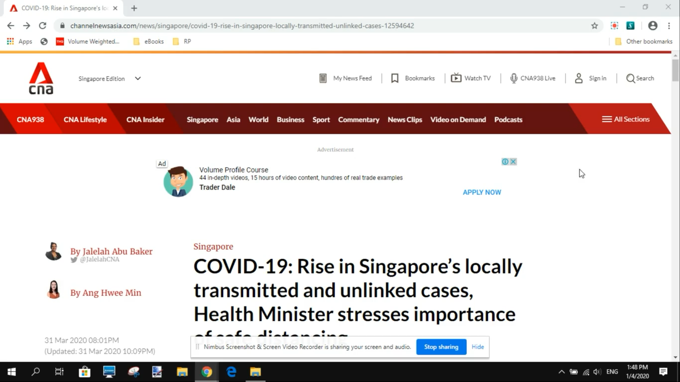
Demonstration - WebApp

Slide 10
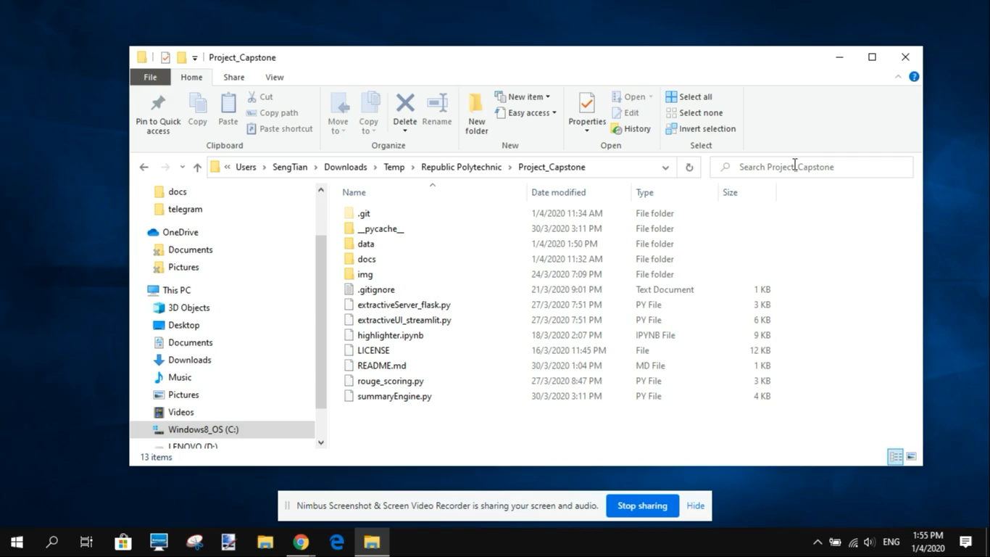
Demonstration – ROUGE Scoring

Slide 11
Learnings & Recommendations
DistillBERT model is the optimal BERT model for a general news extractive summarizer.
A ROUGE scoring model is the most appropriate scoring system as it provides more feedback.
Using a modular coding style, a user could swop out and replace individual parts of the summarizer with minimum effort.
As an improvement, the user can migrate to a full-fletch web development environment, probably using Javascript, HTML5, Bootstrap, jQuery, for example.

Slide 12
Acknowledgement
We would like to thank Timothy and his wonderful team in Nvidia for their technical assistance and guidance throughout the project.
Our project supervisor/mentor, Poh Keam has also been extremely supportive in providing the necessary resources and scoping for this project.
Thank you guys! ☺

Slide 13
Q & A

